Slide 1
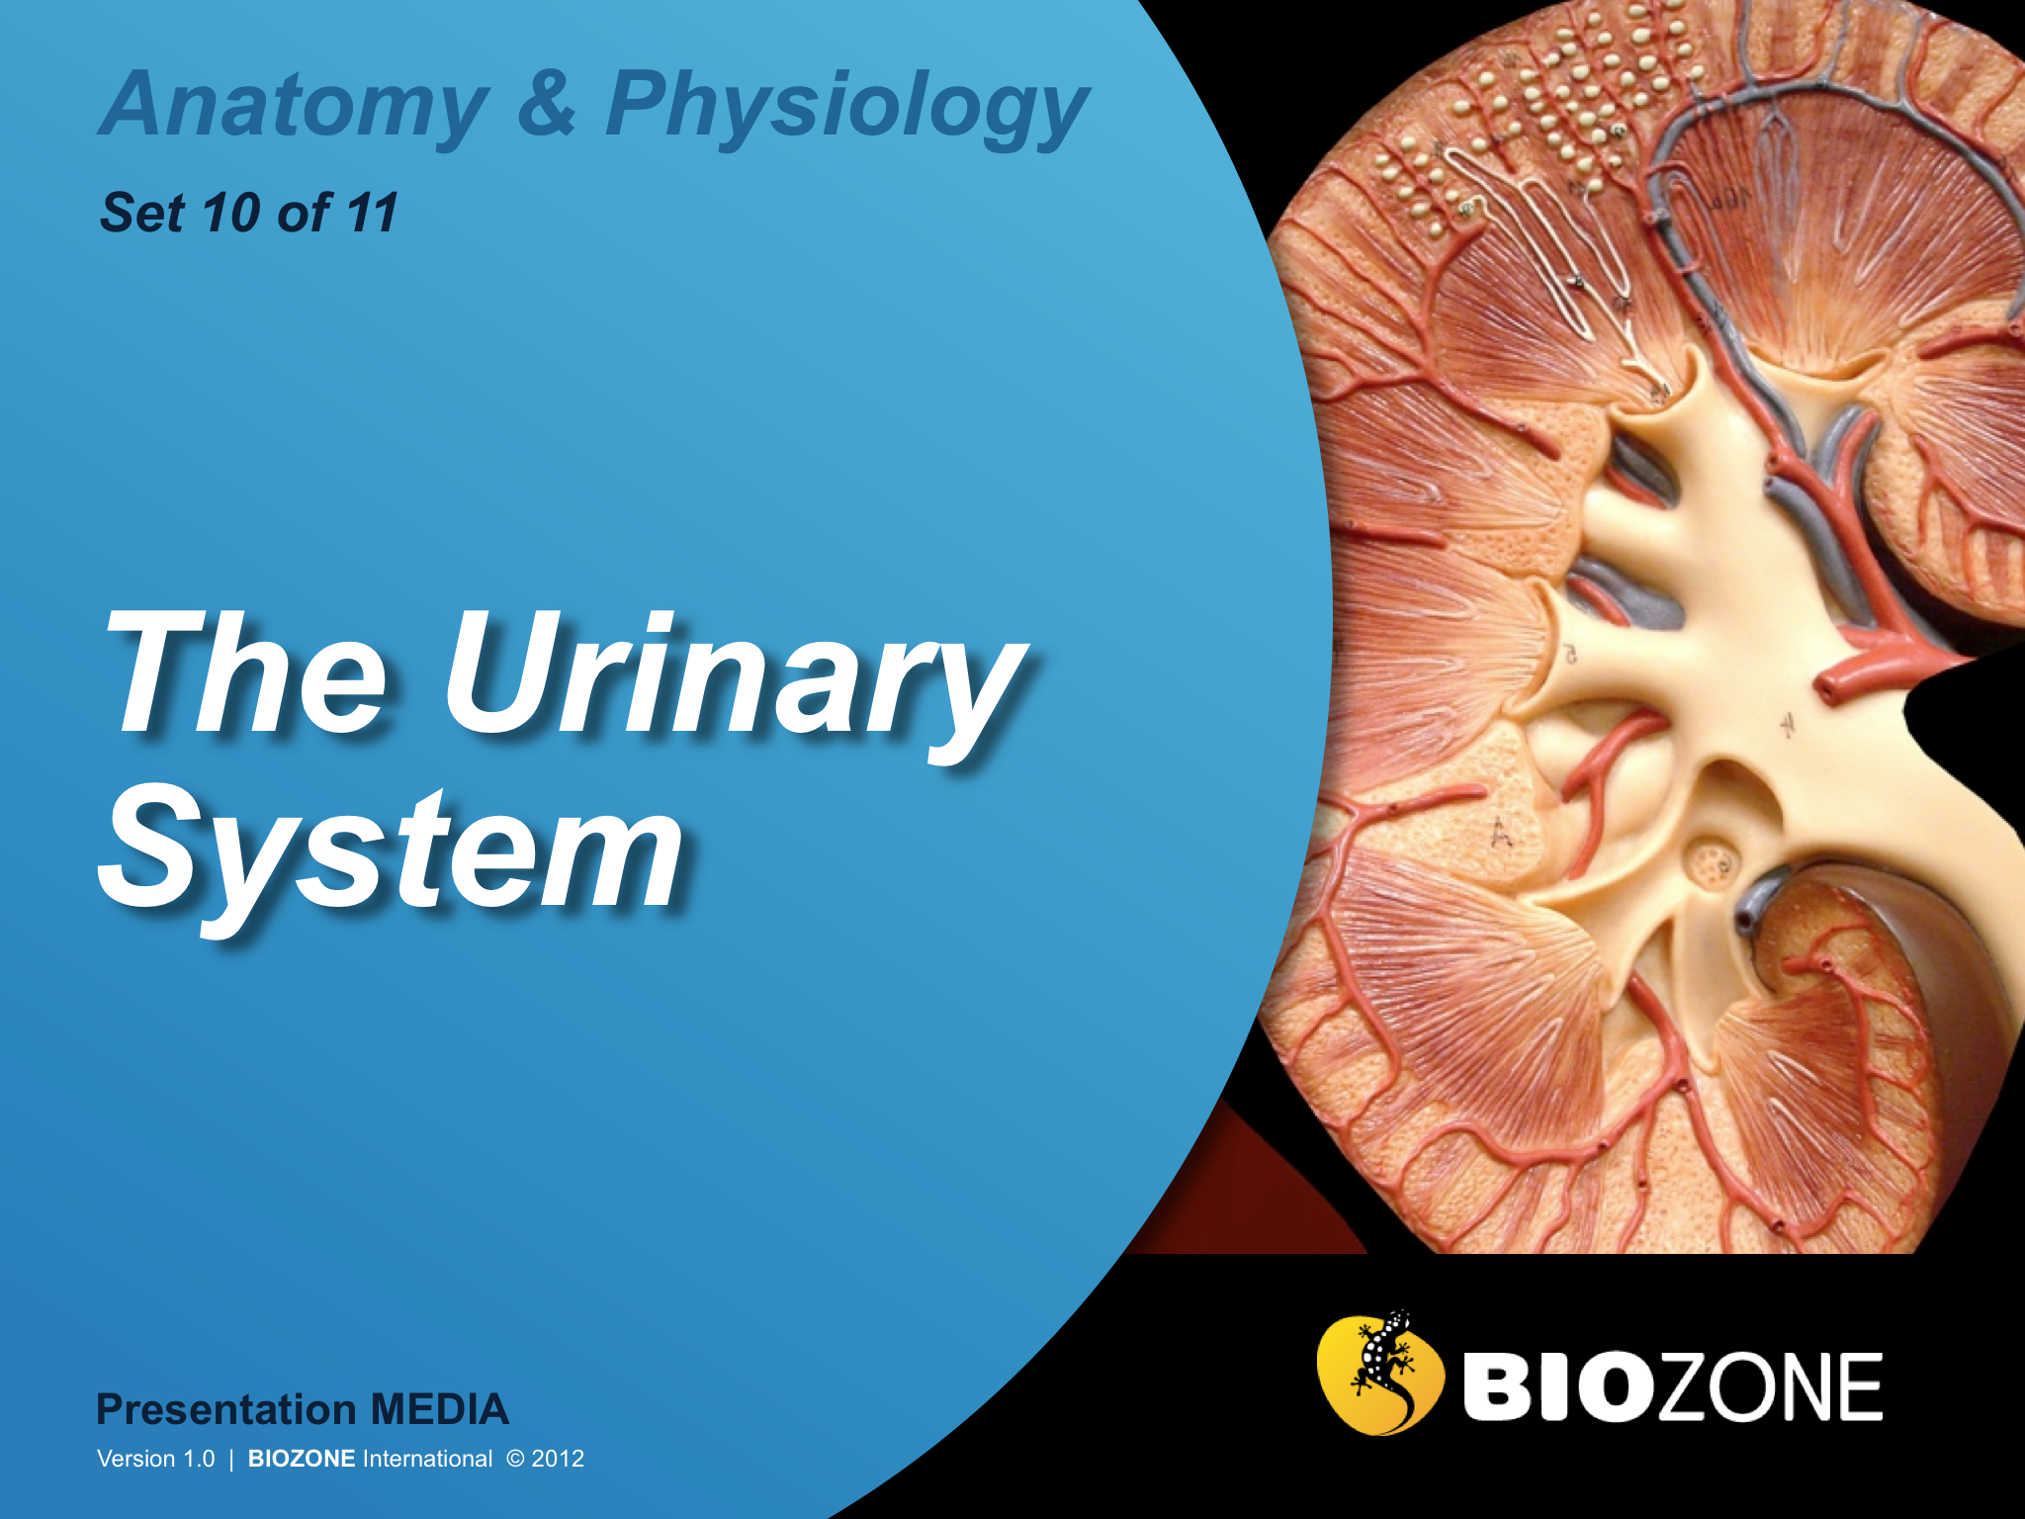

Slide 2
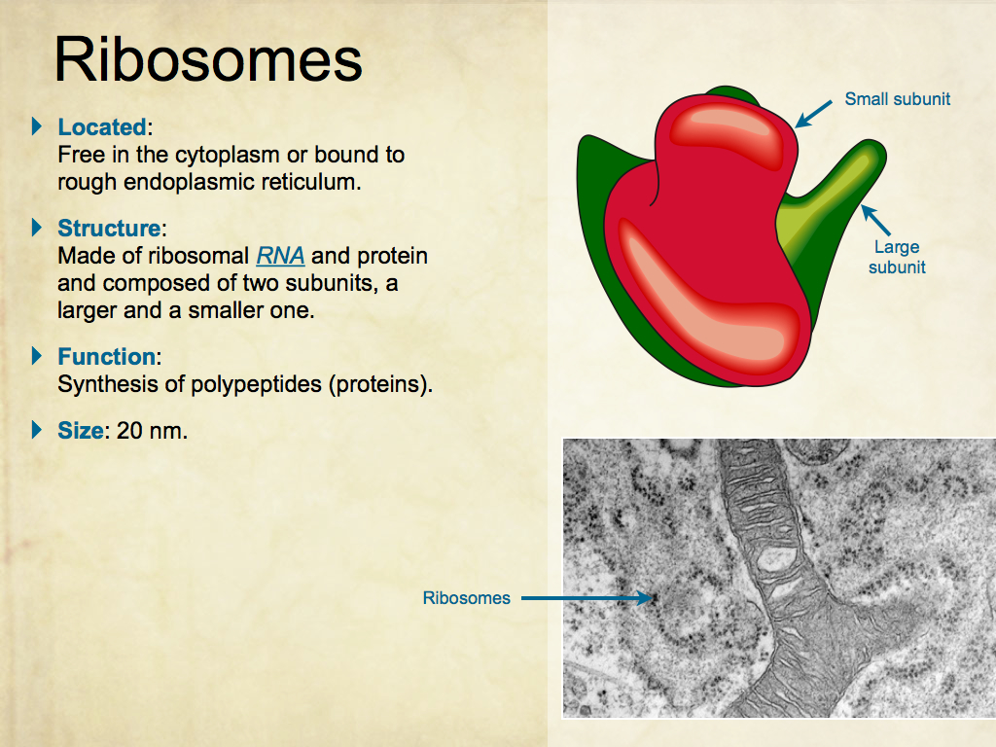
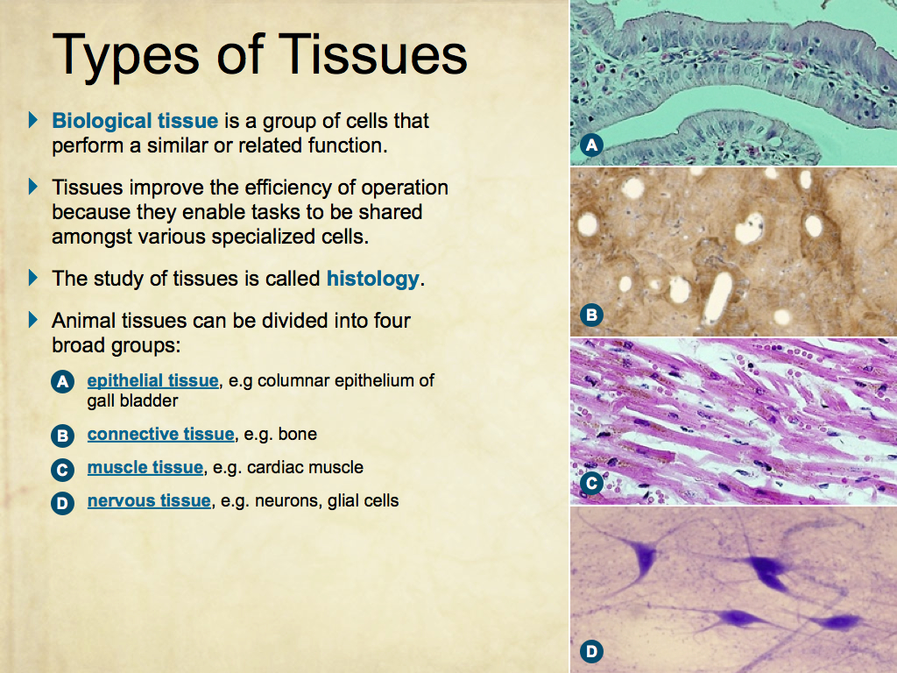
Using Presentation Media
BIOZONE Presentation Media
can be used either as a simple slide show or as an interactive lesson.
  Hyperlinks within the text take you to related slides.
Italicized hyperlinks link to the glossary of definitions.
Bold hyperlinks give direct access to specific slides.

Slide 3
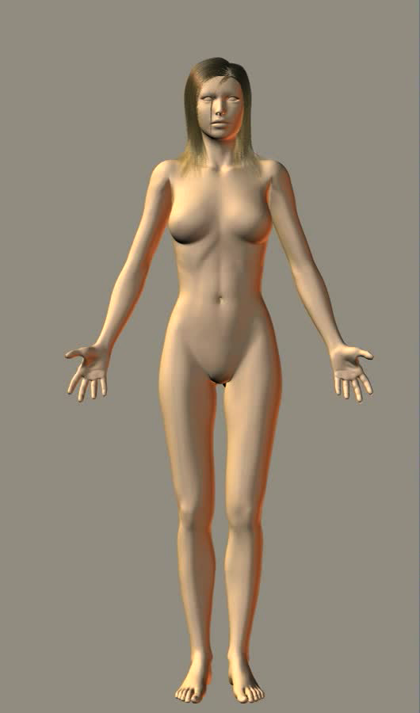
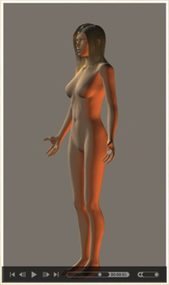
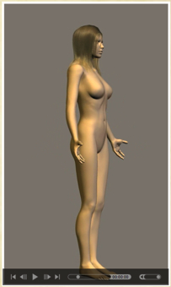
Using Presentation Media
BIOZONE Presentation Media can be used either as a simple slide show or as an interactive lesson
  The movie player allows you to rotate objects.
The movie loops continuously when activated
Use the movie controls in Keynote or Powerpoint
Pause the movie, then drag the slider to rotate the object back and forth

Slide 4

Introduction
  Interacting Systems
  Contexts
Excretion in Humans
  Excretion in humans
  Organs of excretion
  Water budget
Urinalysis
  Urinalysis
The Human Urinary System
  The human urinary system
  The kidney
  Filtration
  Flow of ions and minerals
  Control of urine output
  The renin-angiotensin system
Kidney Disease
  Kidney dialysis
  Kidney transplant
Glossary

Slide 5
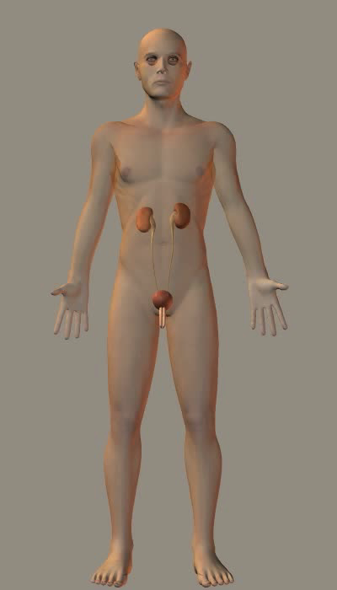
Urinary System
The urinary system (kidneys and associated structures) is responsible for disposing of nitrogenous waste products of metabolism and other toxins.
The kidneys maintain the fluid, electrolyte, and acid-base balance of the body fluids, which is essential for the proper functioning of all body systems.

Slide 6
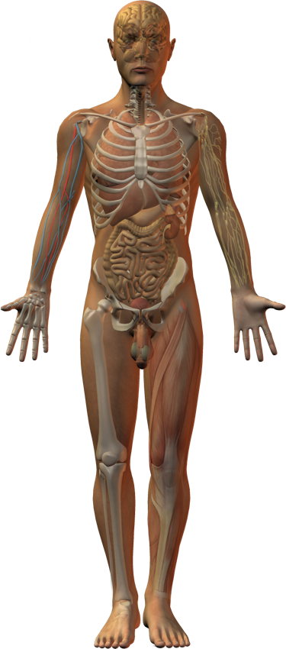
Interacting Systems
Nervous system
Endocrine system
Cardiovascular system
Respiratory system
Compared to the other body systems, the urinary system is relatively simple, comprising paired kidneys and ureters, a urinary bladder, and a urethra.
The primary function of the urinary system is to maintain the composition, volume, and pressure of the blood.
The kidneys are the main functional organ of the urinary system.
Lymphatic system
Reproductive system
Digestive system
Integumentary system
Skeletal system
Muscular system

Slide 7
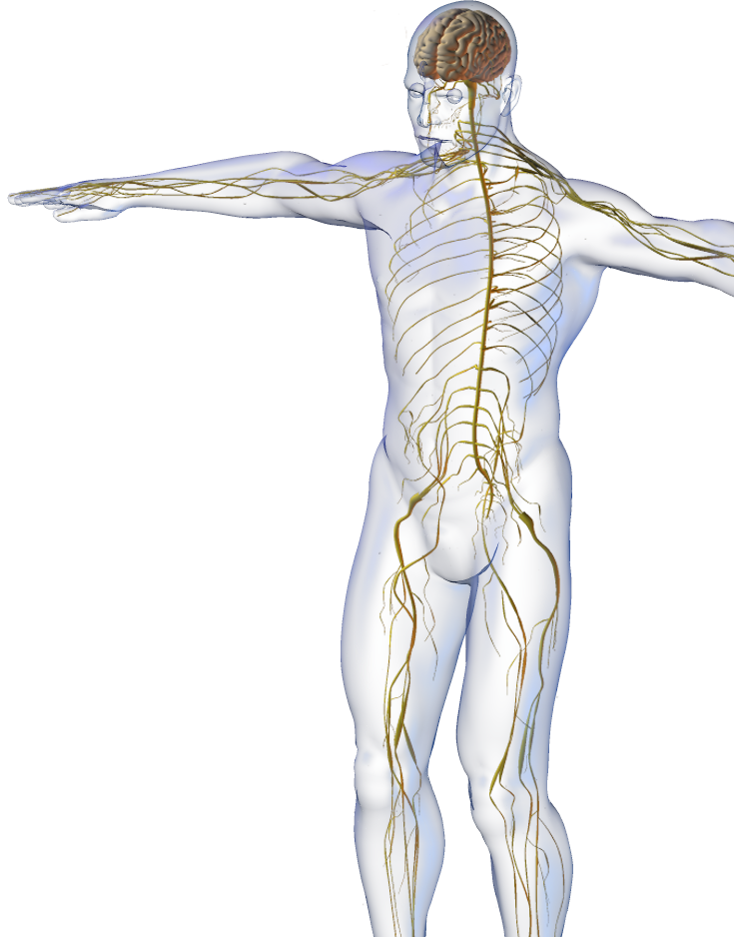
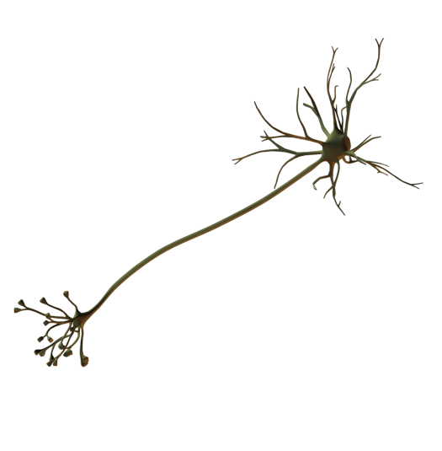

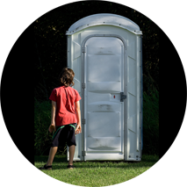
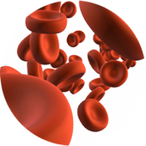
Nervous System
The urinary system interacts with the nervous system.
  Renal regulation of the Na⁺, K⁺, and Ca²⁺ content of the extracellular fluid is necessary for nerve function.
  Micturition (urination) is controlled by voluntary and reflex nervous activity.
  Sympathetic NS activity triggers the renin-angiotensin system responsible for regulation of blood volume.
CA
Istock

Slide 8
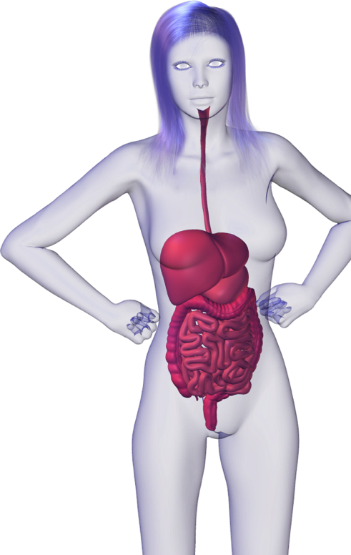
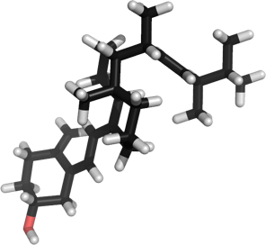
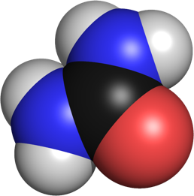

Digestive System
The urinary system interacts with the digestive system.
  The final activation of vitamin D occurs in the kidneys. Bioactive vitamin D is required for calcium absorption in the gut.
  The liver synthesizes most of the body's urea, which is then excreted via the kidneys.
  The digestive system provides nutrients for maintenance and health of the urinary organs.

Slide 9
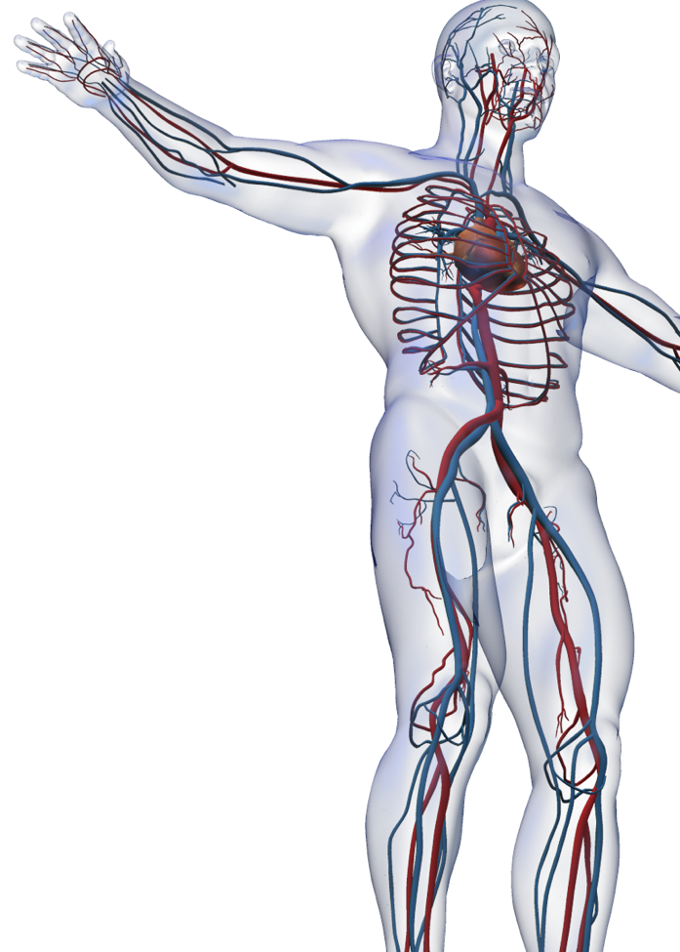
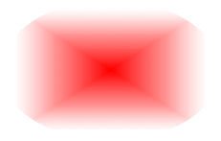
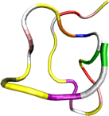
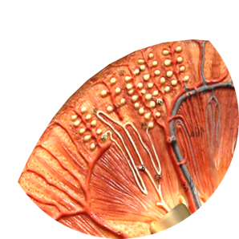
Cardiovascular System
The urinary system interacts with the cardiovascular system.
  Regulation of salt and water balance in the kidney is important in regulation of blood pressure.
  Regulation of blood composition of Na⁺, K⁺, and Ca²⁺ helps maintain heart function.
  Arterial blood pressure is the driving force for glomerular filtration.
  Heart muscle cells secrete a peptide (ANP) in response to high blood pressure. ANP results in greater excretion of Na⁺ and water from the kidney.
  Blood distributes the hormones that influence renal function (e.g. ADH and aldosterone).
Istock

Slide 10
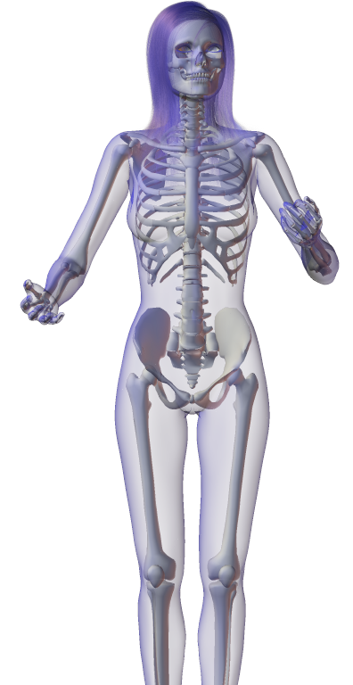
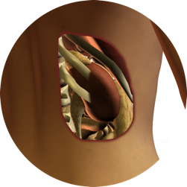
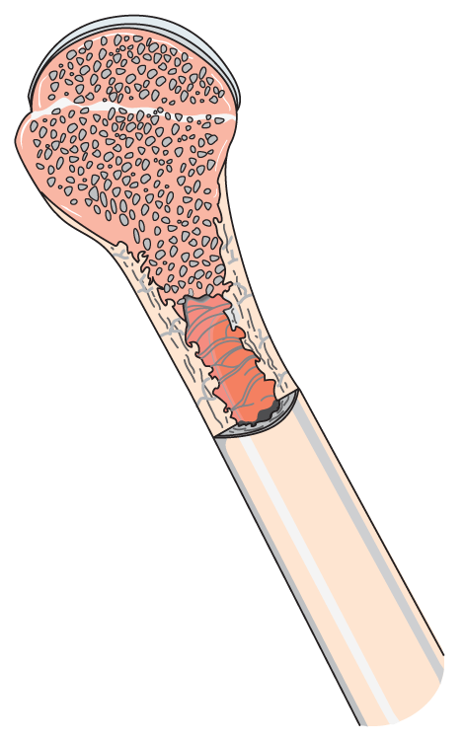
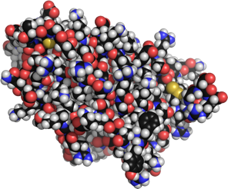
Skeletal System
The urinary system interacts with the skeletal system.
  Bones of the ribcage provide some protection for the kidneys.
  Erythropoietin from the kidneys promotes the formation of red blood cells in the bone marrow.
Istock

Slide 11
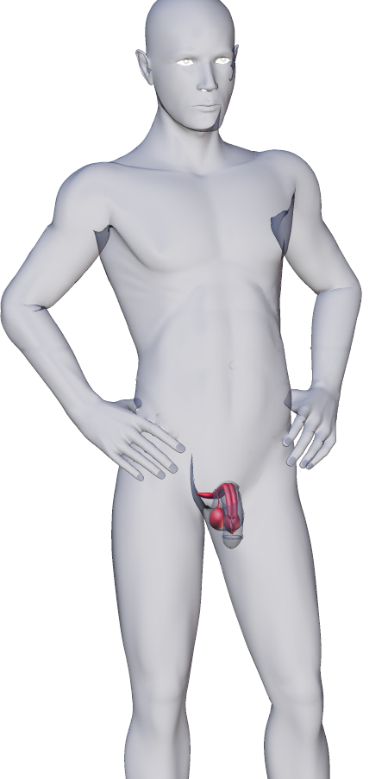
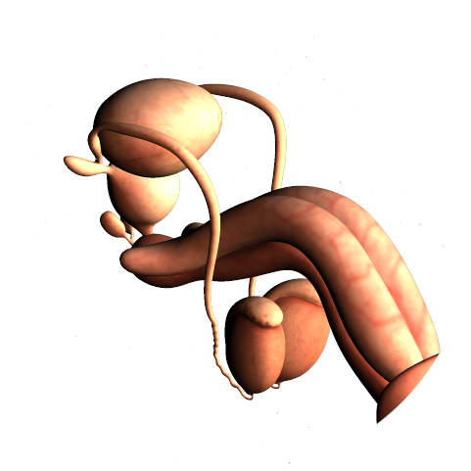
Reproductive System
The urinary system interacts with the reproductive system.
  Urinogenital systems are closely associated. Urethra has an excretory function in both sexes. It also forms part of the genital tract in males, enabling the passage of semen.

Slide 12
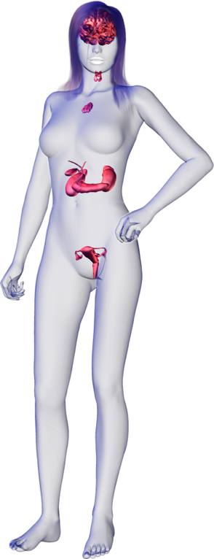
Endocrine System
The urinary system interacts with the endocrine system.
  Kidneys produce erythropoietin, a hormone that promotes the formation of red blood cells in the bone marrow.
  Regulation of salt and water balance by the kidneys maintains the blood volume necessary for hormone transport.
  ADH, ANP, aldosterone and other hormones interact to regulate reabsorption and secretion of water and electrolytes in the kidney (aldosterone causes Na⁺ reabsorption and K⁺ secretion).
Istock
ANP

Slide 13
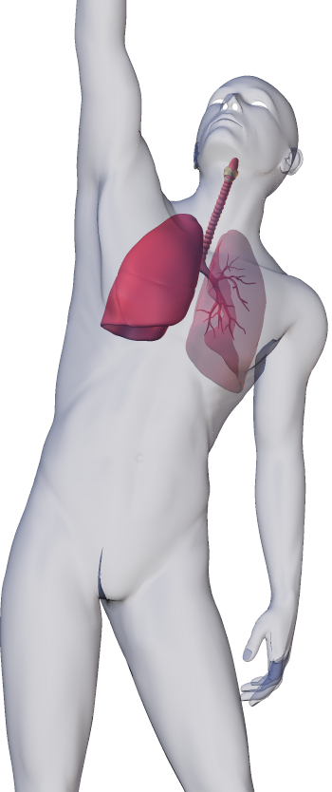
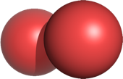
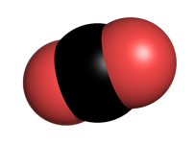
Respiratory System
The urinary system interacts with the respiratory system.
  Respiratory system provides O2 to the urinary system and disposes of CO2 produced by cellular respiration.
  An enzyme in the endothelial cells of the lung capillaries (and other capillaries) converts angiotensin I to angiotensin II (involved in regulation of glomerular filtration).
O2
CO2

Slide 14
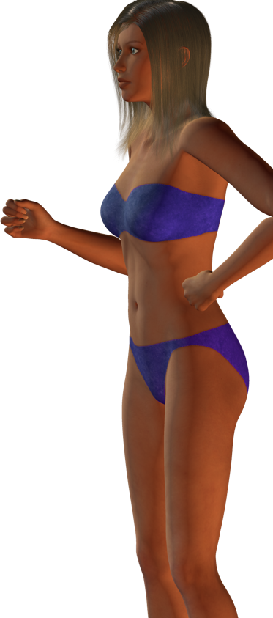

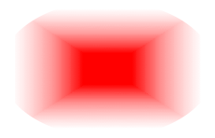
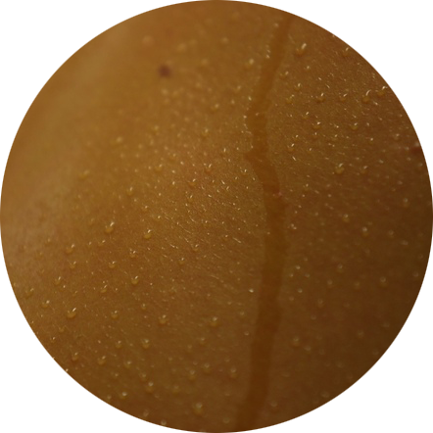
Integumentary System
The urinary system interacts with the integumentary system.
  The skin provides an external protective barrier.
  Final activation of vitamin D (synthesized in the skin) occurs in the kidneys.
  Skin is a site of water loss.
CA

Slide 15
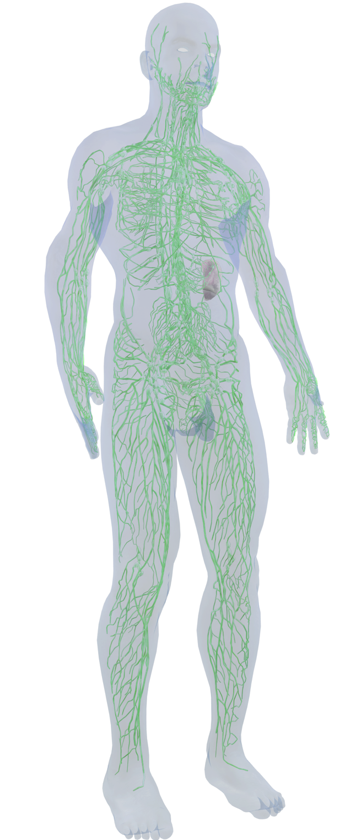
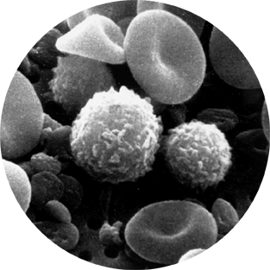
Lymphatic System
The urinary system interacts with the lymphatic system.
  The lymphatic vessels return leaked fluid to the general circulation and help to maintain the blood volume/pressure required for kidney function.
  The immune system protects the urinary organs from infection
  and cancer.
Istock
NCI

Slide 16
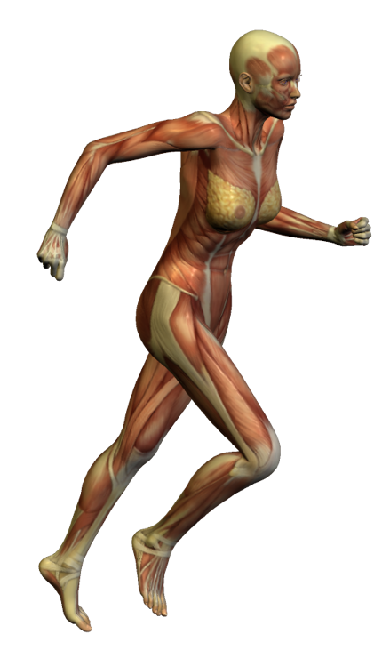



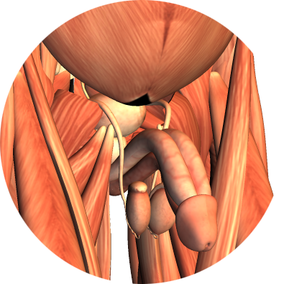
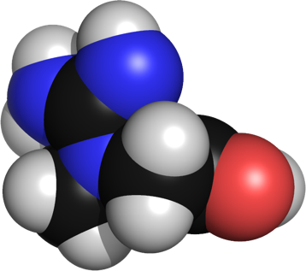
Muscular System
The urinary system interacts with the muscular system.
  Renal regulation of the Na⁺, K⁺, and Ca²⁺ content of the extracellular fluid is necessary for muscle function.
  Muscles of the pelvic floor and external urethral sphincter are involved in voluntary control of micturition.
  Creatinine, which is a break-down product of creatine phosphate in muscle, is produced at a fairly constant rate by the body and must be excreted by the kidneys.
    Serum creatinine provides a measure of the glomerular filtration rate. If the level in the blood is high, it indicates that the kidneys are not functioning normally.

Slide 17
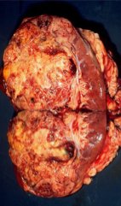
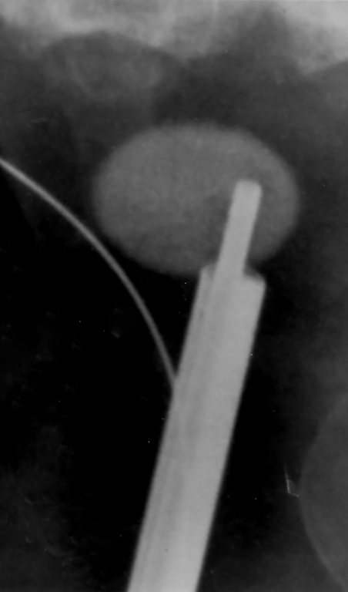
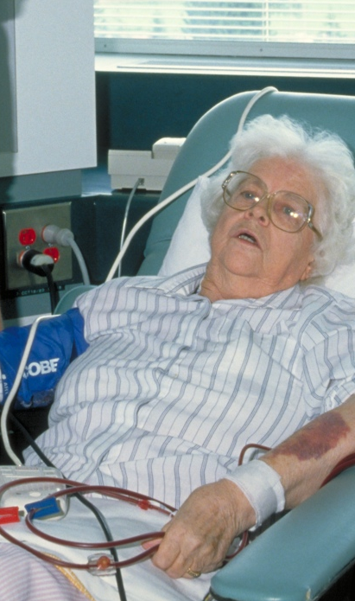
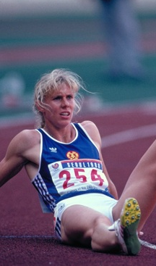
Contexts
Disease
What are the
diseases of
the urinary
system and
what are their
symptoms?
Medicine and Technology
How do we
prevent,
diagnose, and
treat diseases
of the urinary
system?
Waste Removal
The Urinary System
The urinary system has a primary role in excretion of nitrogenous wastes, and in fluid and electrolyte balance.
Degenerative changes in kidney and bladder function can be severe and debilitating. Renal dialysis and transplants are options for sufferers of kidney disease.
Ed Uthman
PHOTO: CDC
PHOTO: NIH
The Effects of Aging
How does
aging affect
the urinary
system?
Exercise
What are the
effects of
exercise on
the urinary
system?
Istock
PHOTO: COR
PHOTO: COR

Slide 18
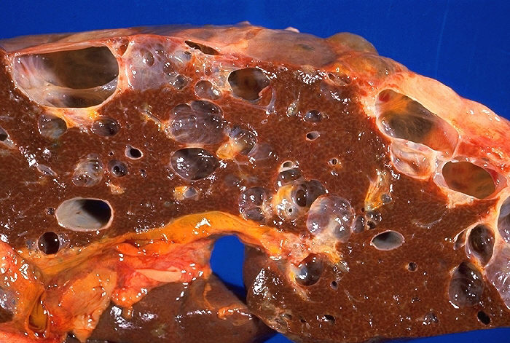
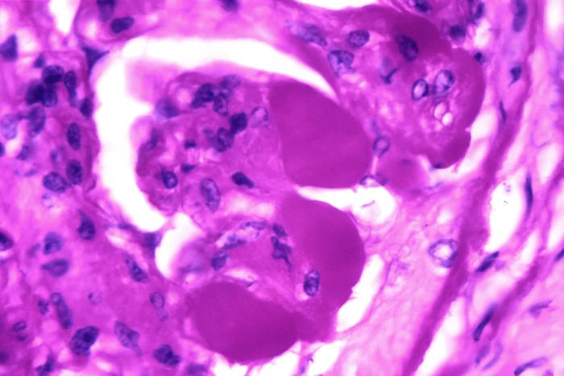
Disease
The urinary system is susceptible to infection and disease which, if left untreated, can be life threatening.
Women are more susceptible to urinary tract infections than men, due to the urethra’s shorter length and closer proximity to the anus.
A common symptom of disease is a general ill-feeling and possible edema.
Polycystic kidney disease
Photo: CDC
Glomerulosclerosis
Image: CDC

Slide 19
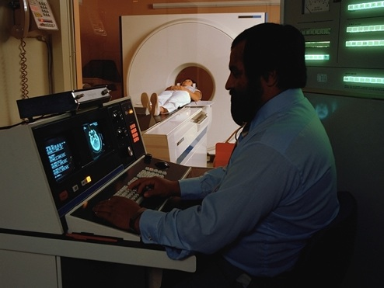
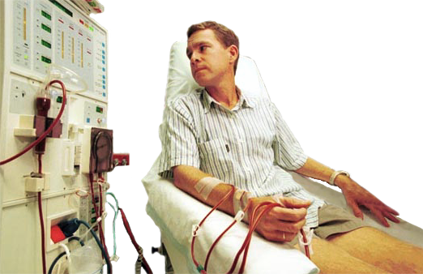
Medicine and Technology
Technological advances have made the diagnosis and treatment of many renal problems easier and safer.
  Computer imaging techniques provide images of the interior and surface of the urinary tract.
  Renal dialysis can replace the function of failed kidneys.
  Kidney transplants are used to replace failed kidneys.
A better understanding of the effects of lifestyle has made prevention of urinary disease more achievable.
EII
AT

Slide 20
Effects of Age
Effect of Age on
Mean Renal Blood Flow
400
Aging has many effects on the urinary system
  Lower number of functional nephrons
    Fewer functioning nephrons reduces the efficiency of the kidneys.
  Reduction in glomerular filtration rate
    Reduced blood flow to the kidneys reduces their ability to filter the blood volume (top, right).
  Reduced response to ADH
    A poor response to ADH leads to edema.
  Prostate enlargement (males)
    Enlarged prostate can prevent normal urination and is common in men over 50.
  Loss of bladder/sphincter muscle tone
    Loss or muscle tone can lead to incontinence (right, bottom).
Flow (mL 100g⁻¹ min⁻¹)
200
JASN
<30
30-40
40-50
50-60
>60
Age (years)
Effect of Age on Urethral Closure Pressure in Women
120
100
Maximum urethral closure pressure (cm H2O)
80
60
40
Trowbridge et al 2007
20
20
30
40
50
60
70
Age (years)

Slide 21
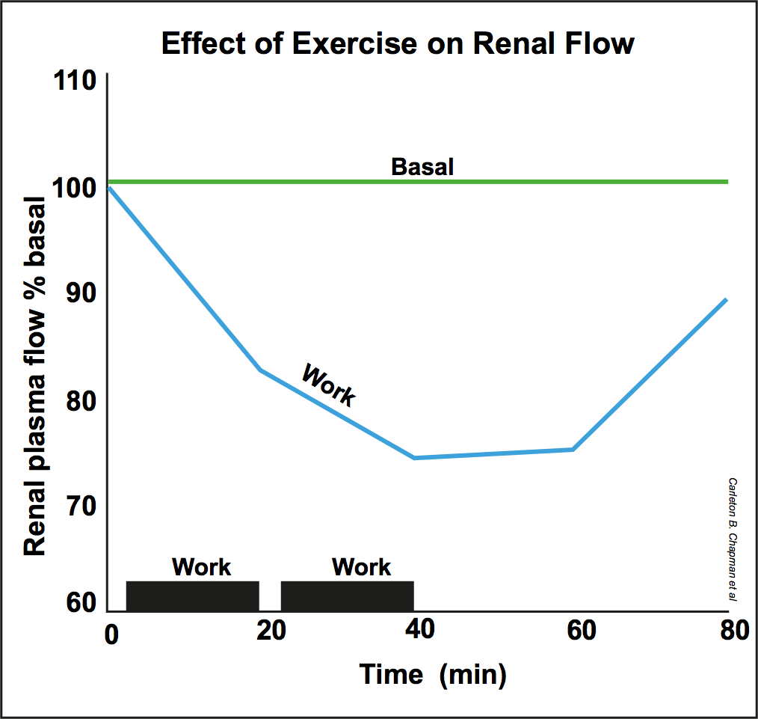
Exercise
As with most other body systems, exercise has a positive effect on the urinary system, up to a point.
  Severe exertion (leading to dehydration) can damage the kidneys.
Exercise lowers blood pressure, therefore...
  Reduces risk of chronic kidney disease
    High blood pressure can damage the blood vessels inside the kidneys.
  Increases rate of creatinine excretion.
    Exercise increases muscle mass which increases the amount of creatinine produced.
  (Rarely) exercise-induced renal failure (dehydration or electrolyte imbalance)
Exercise exerts an anti-diuretic effect and depresses urine clearance. The green line shows normal renal plasma flow, while the blue line shows plasma flow during and after exercise.

Slide 22
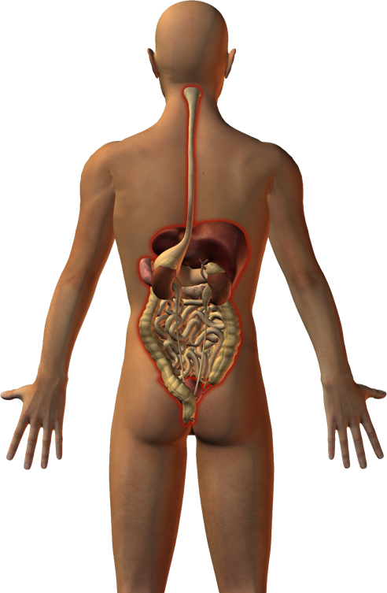
Excretion in Humans
The main organs of excretion are the kidneys, although the skin, gut, and lungs play important roles.
  As well as ridding the body of nitrogenous wastes, the kidneys excrete many unwanted poisons and drugs that are taken in from the environment.
Excretion should not be confused with elimination or egestion of undigested and unabsorbed food material from the gut.
  Note that the breakdown products of hemoglobin (blood pigment) are excreted in bile and pass out with the feces, but these waste products are not the result of digestion.

Slide 23
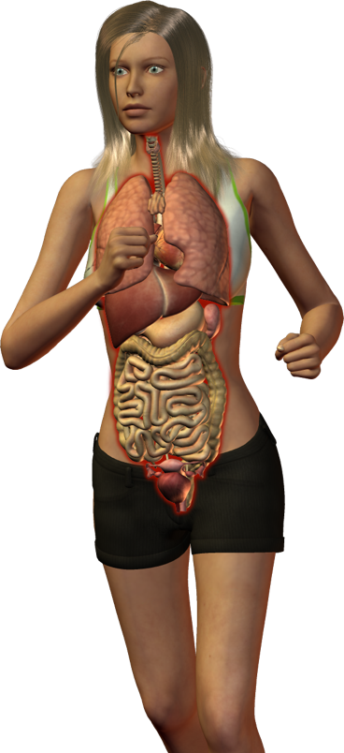
Organs of Excretion
CO2, H2O
Skin
Excretion of water, CO2, hormones, salts, and small amounts of urea as sweat.
Lungs
Excretion of carbon dioxide (CO2) with some loss of water.
Liver
Produces urea from ammonia in the urea cycle. Breakdown of hemoglobin in the liver produces the bile pigment bilirubin.
Gut
Excretion of bile pigments in the feces. Also loses water, salts, and carbon dioxide.
Kidney
Filtration of the blood to remove urea. Unwanted ions and some hormones, along with some drugs and toxins are excreted by the kidneys.
All cells
All the body’s cells respire, breaking down glucose to release energy and produce the waste products carbon dioxide and water.
Bladder
Storage of urine before it is expelled to the outside.

Slide 24
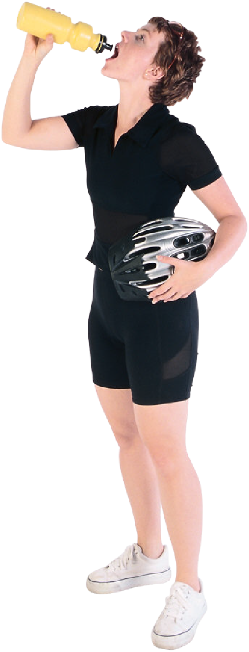
The Role of Water
Moistens tissues in mouth, nose and eyes.
Regulates body temperature
We cannot live without water for more than about 100 hours (about 4 days) as adequate water is required for physiological function and health.
  Body water content varies between individuals and through life, from above about 90% of total weight as a fetus to 74% as an infant, 60% as a child, and around 50-59% in adults, depending on gender and age.
  Males usually have a higher water content than females due to a different amount of body fat.
Lubricates joints
Moistens food, making it easier to swallow.
Adequate hydration maintains optimal kidney function. This is often popularized as water helping to flush out toxins.
Helps provide protection for the organs.
Provides solvent for ions and organic molecules.
Hemera

Slide 25
Water Needs
Dehydration
+
+
+
Decreases flow of saliva, drying mouth and throat
Decreases blood volume and blood pressure
Men need more water than women due to their higher (on average) fat-free mass and energy expenditure.
Infants and young children need more water in proportion to their body weight as they cannot concentrate their urine as efficiently as adults.
Infants also have a greater surface area relative to weight, so water losses from the skin are greater.
Increases blood osmotic pressure and stimulates osmoreceptors in hypothalamus
Increases renin release by juxta-glomerular cells cells of kidneys
–
Increases angiotensin II production
Stimulation of thirst center in hypothalamus
Thirst increased
Increased fluid intake
Water levels restored, dehydration relieved.
Negative feedback system for thirst

Slide 26
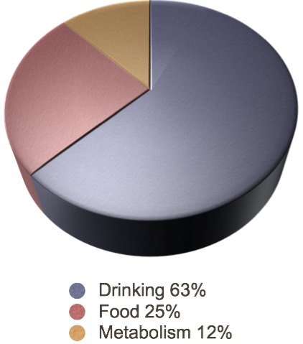

Water Requirements
About 63% of our daily requirement for water is met through drinking fluids, 25% is obtained from food, and the remaining 12% comes from metabolism (the oxidation of glucose to ATP, CO2, and water) .
Typically, we lose 60% of body water through urination, 36% through the skin and lungs, and 4% in feces.
  Losses through the skin and from the lungs (breathing) average about 900 mL per day or more during heavy exercise. These are called insensible losses.
Water Gains
Water Losses

Slide 27



Daily Water Transfers
To tract lumen
Ingested: 2200 mL
Saliva: 1500 mL
Bile: 700 mL
From tract lumen
Intestinal absorption:
8000 - 8400 mL
Gastric secretion: 1500 mL
Colonic salvage:
400 mL
Pancreatic juice: 1500 mL
Intestinal secretion: 1500 mL
Total: 8800 mL
Total: 8900 mL
Water Gains
Water Losses
100 mL water (200 mL feces)

Slide 28


Urine Analysis
Urine is the liquid waste product of the body. It contains water, urea, electrolytes, and other waste metabolites which are filtered out of the blood by the kidneys.
Urine analysis (urinalysis) is used as a diagnostic tool for a wide range of metabolic disorders.
  In addition, urine analysis can be used to detect the presence of prescription and illicit (non-prescription) drugs and for diagnosing pregnancy.
Elite athletes commonly have urine tests to test for the use of performance enhancing drugs.
CA
Urine is composed of the following, in decreasing concentrations:
Water (about 95%)
Urea - 9.3 gL⁻¹
Chloride - 1.87 gL⁻¹
Sodium - 1.17 gL⁻¹
Potassium - 0.750 gL⁻¹
Creatinine - 0.670 gL⁻¹
Various other soluble
ions, and organic and
inorganic compounds.

Slide 29

Macroscopic Urinalysis
A urinalysis (UA) usually includes a full macroscopic analysis, a dipstick chemical analysis, and a microscopic analysis.
  The first part of a urinalysis is direct visual observation. Normal fresh urine is pale to dark yellow or amber in color and clear.
  Turbidity or cloudiness may be caused by excessive cellular material or protein in the urine.
  A red or red-brown (abnormal) color could be from a food dye, eating fresh beets, a drug, or the presence of either hemoglobin or myoglobin.
  The sample right contains many red blood cells, indicating an acute case of hematuria.
Photo: James Heilman CC 3.0

Slide 30

Dipstick Urinalysis
A dipstick chemical test is able to test for many compounds at once.
  Tests include:
    Urine pH: normal range is 4.5-8.0.
    Specific gravity: Normal is 1.002 - 1.035 Specific gravity measures urine density, or the ability of the kidney to concentrate or dilute the urine over that of plasma.
    Protein: Normal total protein excretion does not exceed 10 mg per 100 mL in any single specimen. More than 150 mg per day is defined as proteinuria.
    Glucose: Less than 0.1% of glucose filtered by the glomerulus normally appears in urine. Excess sugar in urine generally indicates diabetes mellitus.
    Ketones: Ketones in the urine result from diabetic ketosis or some other form of calorie deprivation (starvation).
    Nitrite: Nitrites indicate that bacteria may be present in significant numbers.
    Leukocyte esterase: A positive leukocyte esterase test results from the presence of whole or lyzed white blood cells (indicating infection).
Istock

Slide 31

Testing for Anabolic Steroids
Anabolic steroids work by increasing protein synthesis within cells and are legitimately used for medical purposes.
Anabolic steroids are broken down into known metabolites, which are excreted in the urine.
  The presence of specific metabolites indicates which substance has been used by the athlete.
  Some steroid metabolites stay in the body for weeks or months after being taken, while others are eliminated quite rapidly.
  Athletes using anabolic steroids can escape detection by stopping drug use prior
  to competition.
  This allows the body time to break down and eliminate the components, and the drug use goes undetected.
  Heavy use of anabolic steroids comes with health risks (right).
Mice given anabolic steroids for 6 month (from 2 to 8 months) exhibited dramatic life-shortening effects after the end of the treatment, with mice given higher dose showing the greatest effect.

Slide 32

The Human Urinary System
The urinary system consists of the kidneys and bladder, and their associated blood vessels and ducts.
Vena cava returns blood to the heart.
Dorsal aorta supplies oxygenated blood to the body’s tissues and organs.
Kidney produces urine (blood filtration, the removal of waste products, and the regulation of blood volume).
Adrenal glands are associated with, but not part of, the urinary system.
Renal artery carries blood from the aorta to the kidney.
Renal vein (at back)returns the blood from the kidney to the venous circulation.
Ureter carries urine to the bladder.
Bladder stores the urine before it passes out of the body. It can expand to hold about 80% of the daily urine output.
Urethra conducts urine from the bladder to the outside. The urethra is regulated by a voluntary sphincter muscle.

Slide 33


The Urinary Bladder
The urinary bladder is a hollow organ situated in the pelvic cavity.
The shape of the urinary bladder depends on how much urine it contains.
  It is collapsed when empty, spherical when slightly distended, and pear shaped when fully distended.
The average capacity of the urinary bladder is about 750 mL.
  When the volume of urine reaches about 400 mL stretch receptors in the bladder wall send signals that initiate the micturition reflex, causing relaxation of the internal urethral sphincter.
  Urination does not take place until the external urethral sphincter (under conscious control) receives signals from the cerebral cortex that inhibit its action and cause it to relax.
Istock
Epithelium
Lumen
EII
Transitional epithelium lines the bladder. This type of epithelium is layered, or stratified, and can be stretched without the outer cells breaking apart from each other.

Slide 34

The Kidney
Each day the kidneys filter about 180 L of plasma.
  Most of this is reabsorbed, leaving a daily urine output of about 1 L.
  The kidneys help to maintain the body’s internal chemical balance by adjusting the composition of the fluid excreted.
The ability of the kidneys to concentrate the urine improves with maturity.
  It is less efficient in infants and young children, who produce relatively larger amounts of dilute urine and are also more susceptible to dehydration
Renal artery
Renal vein
Ureter
Anatomist90 CC 3.0
Left kidney of cadaver showing renal vein and artery and ureter.

Slide 35

Internal Kidney Structure
The functional unit of the kidney is the nephron.
  The striated appearance of the
  kidney tissue is due to the alignment of the nephrons.
Each kidney contains more than
1 million nephrons.
  They are selective filter elements, which regulate blood composition and pH, and excrete wastes and toxins.
Nephron
Outer cortex
Inner medulla
The urine collects in a space near the ureter called the renal pelvis before flowing out of the kidney via the ureter.
Ureter
Urine flow

Slide 36

Nephron Structure
Proximal convoluted tubule
Efferent arteriole (leaves glomerulus)
Distal convoluted tubule
Afferent arteriole (enter glomerulus)
Glomerulus
Bowman’s capsule
Descending limb of the loop of Henle
Cortex
Medulla
Venule
Ascending limb of the loop of Henle
Blood vessels (the vasa recta)
The collecting duct drains to the renal pelvis
Loop of Henle

Slide 37

Filtration
Glomerulus
Bowman’s capsule
Filtrate
The passage of water and solutes into the nephron and the formation of the glomerular filtrate depends on the pressure of the blood entering the afferent arteriole.
  If it increases, filtration rate increases; when it falls, glomerular filtration rate also falls.
  This process is so precisely regulated that, in spite of fluctuations in arteriolar pressure, glomerular filtration rate per day stays constant.
  After formation of the initial filtrate, the urine is modified through secretion and tubular reabsorption according to physiological needs at the time.
Blood flow
Loop of Henle
Collecting duct

Slide 38


Bowman’s Capsule
Glomerulus
Capsular space
PHOTO: EII
Parietal layer
Visceral layer
Bowman’s capsule is a double-walled cup, lying in the cortex of the kidney.
  It encloses a capillary network called
  the glomerulus.
  The capsule and its enclosed glomerulus form a renal corpuscle.
The outer (parietal) layer of Bowman’s capsule is separated from the inner (visceral) layer by the capsular space.
Convoluted tubules
Bowman’s capsule
T.S. of glomerulus and Bowman’s capsule
Capsular space
Glomerulus
Parietal layer
Bowman’s capsule
Visceral layer
T.S. diagram of glomerulus and Bowman’s capsule

Slide 39


Podocytes
Podocyte cell body
Image: SecretDisc CC3.0
Filtration slits
The visceral epithelium of Bowman’s capsule comprises specialized epithelial cells called podocytes.
The finger-like cellular processes of the podocytes wrap around the glomerular capillaries. The plasma filtrate passes through the filtration slits between them.
Podocyte wrapped around glomerular capillary.
Capillaries
Podocyte cell bodies
Podocyte cellular processes
Capsular space
T.S. diagram of glomerulus and Bowman’s capsule

Slide 40

Flow of Ions and Minerals
The filtrate from that enters the proximal convoluted tubule contains both wastes and useful substances (such as ions, glucose, and amino acids).
  These must be returned to the blood from the filtrate.
  The cells lining the tubules transport these substances from the tubules out into the extracellular space from where they are absorbed into the capillaries.
  Transport may be passive (e.g. diffusion) or active.
Na⁺
B
W
G
Na⁺
B
G
Na⁺
U
B
W
K⁺
K⁺
W
Na⁺
W
Na⁺
Na⁺
W
Key
Na⁺
Na⁺, Cl⁻
W
H2O
Reabsorption (active)
K⁺
K⁺ and H⁺
G
Glucose, amino acids
Reabsorption (passive)
HCO3⁻
Urea
Secretion (active)
U
B
U

Slide 41


Control of Urine Output
Variations in salt and water intake, and in the environmental conditions to which we are exposed, contribute to fluctuations in blood volume and composition.
The primary role of the kidneys is to regulate blood volume and composition (including the removal of nitrogenous wastes), so that homeostasis is maintained.
  This is achieved through varying the volume and composition of the urine. Two hormones, antidiuretic hormone (ADH) and aldosterone, are involved in the process.
Aldosterone produced by the adrenal cortex
ADH released from the posterior pituitary
Hemera

Slide 42


Aldosterone and ADH
Osmoreceptors in the hypothalamus detect a fall in the plasma volume.
  They stimulate neurosecretory cells in the hypothalamus to synthesize and secrete the hormone ADH (antidiuretic hormone).
ADH passes from the hypothalamus to the posterior pituitary where it is released into the blood.
  ADH increases the permeability of the kidney collecting duct to water so that more water is reabsorbed and urine volume decreases.
Aldosterone acts on the distal tubules and collecting ducts of the nephron, causing conservation of sodium ions and secretion of potassium ions.
ADH
Aldosterone

Slide 43

Release and Inhibition
Factors inhibiting ADH release
• Low solute concentration • High blood volume
• Low blood sodium levels
• High fluid intake
• Alcohol consumption
Factors causing release of aldosterone
Low blood volumes also stimulate secretion of aldosterone from the adrenal cortex. This is mediated through a complex pathway involving the hormone renin from the kidney.
Factors causing ADH release
• High solute concentration • Low blood volume
• High blood sodium levels
• Low fluid intake
• Nicotine and morphine
Water reabsorption increases.
Urine output decreases.
Water reabsorption decreases.
Urine output increases.
Na+ absorption increases, water follows, blood volume restored.
ADH

Slide 44

Fluid Balance
The body's fluid and electrolyte balance is critical to metabolic function.
  Water makes up around 60% of the body and is found within two main fluid compartments.
    The intracellular fluid makes up 60-66% of the water in the body and is found within the body's cells.
    The extracellular fluid makes up the rest of the body's water and can be divided into intravascular fluid (mostly blood) and the extravascular fluid (interstitial fluid around the cells).
40 %
solids
66%
intracellular
fluid
60%
fluids
33%
extracellular
fluid
80%
interstitial
fluid
20% plasma
Fluids and solids in an average person

Slide 45
Electrolyte Balance
Electrolyte concentration in body’s fluid compartment.
Plasma
Extracellular fluid
Electrolytes in the body fluids are responsible for maintaining osmotic gradients and permitting ion exchanges.
  For example, in the blood plasma, electrolytes help to maintain the blood volume by keeping water moving into the capillaries.
When electrolyte (mostly Na⁺) levels fall, water moves out of the capillaries and into the tissues.
  This causes blood volume and pressure to fall and plasma to thicken.
Interstitial fluid
Intracellular fluid
25
50
75
100
125
150
175
200
mEq L^{-1 *}
Key
Cations:
Mg²⁺
Ca²⁺
Na⁺
K⁺
Anions:
Protein anions
SO4²⁻
HPO4²⁻
Cl⁻
HCO3⁻
H2CO3
Organic acids
* mEq L⁻¹: Milliequivalents per liter
1 mEq is equal to the charge in 1 mmol of H⁺.
Concentration in mEq L⁻¹ = concentration in mmol L⁻¹ x the charge of the ion. e.g mEq Ca²⁺ = 2 x mmol L⁻¹ Ca²⁺

Slide 46



The Renin-Angiotensin System
Aldosterone promotes sodium reabsorption in the kidney tubules.
  The most important mechanism for regulating its release is the renin-angiotensin system (RAS).
  The RAS is mediated by the juxtaglomerular (JG) apparatus in the renal tubules (juxta- means near).
Loss of blood pressure or volume
Distal convoluted tubule retains Na⁺ and H2O
+
Filtrate volume reduced
Aldosterone production by adrenal cortex leads to retention of Na⁺ (and H2O by osmosis)
Juxtaglomerular cells stimulated
+
–
Renin produced
Angiotensin II production
Vasoconstriction of blood vessels increases peripheral resistance
Blood volume and pressure increase
+
Blood volume restored
When blood volume is low, the JG apparatus secretes renin into the blood. Renin catalyzes the formation of angiotensin II in the blood.
Thirst center is stimulated, promoting drinking
+

Slide 47

Acid-Base Balance
Lungs remove CO2
Kidneys excrete HCO3¯ or H⁺
The pH of the body's fluids must be maintained within a very narrow range (pH 7.35-7.45).
  The products of metabolic activity (e.g. CO2) are generally acidic and could alter pH considerably without a buffer system to counteract pH changes.
The carbonic acid-bicarbonate buffer works throughout the body to maintain the pH of blood plasma close to 7.40.
  The body maintains the buffer by eliminating either the acid (carbonic acid) or the base (bicarbonate ions).
The blood buffers, the lungs, and the kidneys represent the three systems counteracting disturbances of pH homeostasis.
Blood uses carbonate-bicarbonate buffer

Slide 48

The Blood Buffer System
A buffer is able to resist changes to the pH of a fluid when either an acid or base is added to it.
  The bicarbonate ion (HCO3⁻) and its acid, carbonic acid (H2CO3), work in the following way:
H⁺ + HCO3¯
Excess H⁺ ions are removed by HCO3¯.
H2CO3
A deficit of H⁺ ions is corrected by the dissociation of carbonic added.
H2CO3
H⁺ + HCO3¯
If a strong acid is added to the system, a weak acid is formed and thus the pH falls only slightly.
  Note that the blood also contains proteins, which contain basic and acidic groups that may act either as H⁺ acceptors or donors to help maintain blood pH.

Slide 49

The Respiratory System
Carbon dioxide (CO2) in the blood (an end-product of cellular respiration) forms carbonic acid (H2CO3) which dissociates to form H⁺ and bicarbonate (HCO3¯).
This means that as CO2 rises in the blood so too does the H⁺ concentration.
  Chemoreceptors in the brain detect the rise in H⁺ ions and increase the rate of breathing to expel the CO2.
  Low levels of CO2 have the effect of depressing the respiratory system so that H⁺ builds up and the pH is once again restored.
Signal to brain
Cellular respiration produces CO2:
CO2 + H2O H2CO3¯
Increase in breathing rate
H2CO3 H⁺ + HCO3¯

Slide 50

The Renal System
The kidneys regulate the concentration of HCO3¯ by conserving or excreting the H⁺ in the glomerular filtrate.
When blood pH rises H⁺ is retained by the tubule cells.
Conversely, when blood pH falls, H⁺ is actively secreted into the kidney tubule.
Urine pH normally varies from 4.5 to 8.0, reflecting the ability of the renal tubules to retain or lose ions to maintain the homeostasis of blood pH.
Retained H⁺
Removal H⁺
Equivalent to
Removal HCO3¯
Gain HCO3¯
The renal system acts more slowly in controlling blood pH than the blood buffer or the respiratory systems. However, it can permanently eliminate metabolic acids and regulate alkaline substances by either excreting or retaining ions.

Slide 51

Reabsorption of HCO3¯
Bicarbonate makes up part of the filtrate from the glomerulus into the convoluted tubules.
  Virtually all of it is reabsorbed into the blood by a series of chemical reactions, as there is no molecule to transport HCO3¯ from the convoluted tubules to the tubule cells.
Tubule lumen
Proximal convoluted tubule cell
Capillary
Na⁺/H⁺ antiporter
Interstitial fluid
HCO3¯
Na⁺
Na⁺
Na⁺
H⁺
H⁺
H2CO3
HCO3¯
HCO3¯
H2CO3
H2O
CO2
CO2
H2O
The reabsorption of HCO3¯ ions is coupled with the reabsorption of Na⁺ ions and accompanies the secretion of H⁺ ions.

Slide 52


Symptoms of Disease
Symptoms of disease include:
  Pain (moderate to severe)
    The most common symptom of an infection of the urinary system is pain while urinating. Another is an unexplained soreness in the lower back.
  Abnormal urine composition or volume
  Abnormal electrolyte balance
  Abnormal fluid balance
    Changes to the composition of the urine, or its volume may indicate a problem with the kidneys, bladder, or prostrate.
    Changes in fluid balance can indicate dehydration or kidney failure.
Istock

Slide 53

Disease and Disorders
Diseases and disorders of the urinary system can range from being inconvenient to life threatening.
  Kidney stones (renal calculus)
    Kidney stones form as crystalline deposits of calcium and other salts. They can be left in place with few ill effects, but can be also be broken up using high frequency sound waves.
  Hereditary disorders
    Inherited disorders include autosomal dominant polycystic kidney disease, medullary sponge kidney, and medullary cystic disease.
  Nephrotic syndrome
    A non-specific disease caused by damage
    to the kidneys (from various diseases or disorders). Symptoms include protein in the urine.
Kidney stone
Photo: Robert R. Wal

Slide 54

Disease and Disorders
Congenital diseases (malformations)
  These may include renal dysplasia, obstruction of the renal tract and cystic diseases.
Bladder and kidney cancer
  Cancers of the bladder and kidneys can affect the body’s ability to filter blood and remove wastes. These can be as life threatening as the cancer itself.
Chronic kidney disease (CKD)
  This is the slow but progressive loss of kidney function. Symptoms are often non-specific at first and there is no real treatment that can slow its progress.
Incontinence
  The involuntary leaking of urine from the bladder often occurs when the pelvic floor muscles and the sphincter muscle of the bladder are weakened. This may occur during pregnancy and following childbirth in women and is more common in elderly people.
Kidney
Cancerous tumor
Renal carcinoma
Photo: Ed Uthman

Slide 55

Diagnosis of Disorders
Diagnosis of urinary system disorders can be as simple as a urine test or involve computer assisted technologies.
  MRI scans
    MRI scans are useful for viewing the kidneys
    and bladder.
  Kidney biopsy
    Kidney biopsies are often used for diagnosis when there is blood, excess protein, or excessive waste products in the urine.
  Urine tests
    The composition of the urine can help diagnose a possible disorder. Urinalysis can also be used for testing for steroid or other drug use.
  Blood tests
    Elevated levels of certain substances in the blood, such as creatinine, can indicate kidney disease. The creatinine clearance rate provides a measure of the filtration rate of the kidneys.
COR

Slide 56

Prevention of Urinary System Disorders
Prevention of urinary system disorders is always better than treatment.
  Control of hypertension
    Keeping blood pressure low reduces the stress on the blood vessels in the kidney.
  Control of diabetes
    Diabetes is one of the most common causes of kidney failure. High glucose levels cause high blood pressure which damages the capillaries of the glomerulus.
  Control of weight
    Overweight or obese people have higher rates of kidney failure than people with a recommended weight, partly because of their greater risk of diabetes.
  Behaviors to reduce risk of urinary tract infections.
US Dept. Health

Slide 57

Treatment of Urinary System Disorders
Urinary system disorders can be treated by:
  Drug therapy (e.g. antibiotics)
    Antibiotics are commonly used to treat urinary tract infections.
  Physical therapy (e.g for pelvic floor dysfunction)
    Weak pelvic floor and sphincter muscles (which cause incontinence) can be strengthened by targeted exercises.
  Surgery (e.g. removal of kidney stones)
    Kidney stones that are larger than 5 mm require surgical removal.
  Transplant (e.g. of donor kidney)
    Diseased kidneys can be replaced with a matched donor kidney.
  Renal dialysis
    Renal dialysis may take several hours a day, and is used in cases of kidney failure.
CA
Maintaining good oral hydration with water reduces the risk of the developing kidney stones by helping to maintain healthy electrolyte levels in the blood.

Slide 58

Renal Failure
Kidney (renal) failure may be acute (rapid onset) or chronic (developing over many months).
  Acute kidney failure may be reversed, but chronic kidney failure cannot.
Kidney failure is indicated by a rise in serum creatinine as well as by ultrasound.
  Creatinine is a breakdown product of creatine phosphate in the muscles. It is filtered out of the blood by the kidneys. A rise in serum (blood) creatinine levels indicates reduction in kidney function.
Kidney failure may be a result of poorly controlled diabetes, high blood pressure, or polycystic kidney disease.
Photo: Ed Uthman
Kidney showing a rare case of diffuse proliferative lupus nephritis caused by uncontrollable bleeding.

Slide 59


Kidney Dialysis
Kidney (renal) dialysis is a technique used to remove waste products from the blood and excess fluid from the body.
It is used as a treatment for kidney failure.
CDC
Ureter
Large and numerous cysts
This kidney has been removed from a patient suffering from polycystic kidney disease, an inherited disorder that leads to kidney failure.
Dialysis machine
AT

Slide 60

How Kidney Dialysis Works
Key
Waste products
Arterial blood containing blood proteins and waste products
Blood proteins
Flow of dialyzate
Flow of blood
Blood pump
Dialysate delivery system
Diffusion of wastes such as urea
Dialyzing membrane
Clot and bubble trap
Used dialyzate containing the waste products of metabolism
Fresh dialyzing solution (dialyzate) oxygenated and at the correct temperature
Dialyzed blood with wastes removed returns to the venous system

Slide 61

Flow Across the Dialysis Membrane
The dialysis fluid flows at a rate of several 100 mL per minute over a large surface area.
Blood flows through a system of tubes composed of selectively permeable membranes.
Dialyzate flows in the opposite direction (countercurrent) to the blood on the outside of the dialysis tubes.
Direction of blood flow
Dialysis fluid (dialyzate) has a composition similar to blood except that the concentration of wastes is low.
Waste products such as urea diffuse from the blood into the dialysis fluid, which is constantly replaced.
Blood with wastes removed is returned to the patient

Slide 62


Kidney Transplant
The need for a kidney transplant occurs when a patient reaches end stage renal failure, which has many causes including diabetes and high blood pressure.
For the transplant to have the highest chance of success possible, the donor and the recipient must be genetically similar.
The kidney can come from a dead or living donor (as the blood can be filtered efficiently by only one kidney).
Polycystic Kidneys
CDC
Kidney ready for transplant
Istock

Slide 63

Kidney Transplant
An incision is usually made in the lower right abdomen and the donor kidney is transplanted into the lower right pelvic cavity of the recipient.
  Blood vessels from the donor kidney are connected to the blood vessels leading to and from the right leg (the iliac vessels). The ureter to connected to the bladder.
  In most cases, the recipient’s own kidney is left in place. This is to lower the risk of post-operative problems.
  Recipients will need to take immunosuppressant drugs for the rest of their life following the operation.
Donor kidney
Renal artery
Renal vein
Right iliac artery
Ureter
Right iliac vein
Bladder

Slide 64
Electrolyte | Substance containing ions that can dissociate in water to conduct electricity.
Epithelium | A sheet of cells tightly bound together lining cavities and surfaces of structures in multicellular organisms.
Hemoglobin | A large iron-containing protein, which transports oxygen in the blood of vertebrates.
Homeostasis | The relative physiological constancy of the body despite external fluctuations.
Hormone | A chemical messenger that induces a specific physiological response in a target tissue.
Hypothalamus | The region of the brain which coordinates the nervous and endocrine systems via the pituitary gland.
Peptide | A short amino acid polymer. Distinguished from larger protein molecules by its smaller molecular size (fewer than 50 amino acids).
Plasma | The fluid component of the blood. It makes up about 55% of the blood volume and contains contains dissolved proteins, glucose, clotting factors, mineral ions, hormones and carbon dioxide.
Sympathetic nervous system | A branch of the autonomic nervous system that has generally excitatory effects.

Slide 65


Slide 66
Conditions of Use
NOTE: Presentation Media = presentations available on CD-ROM/DVD-ROM or as downloads
BIOZONE retains copyright to the intellectual property included in the Presentation Media files, with acknowledgement that certain photos are used under license and are credited appropriately.
You MAY:
Use the Presentation Media files for presentations in your classrooms using a
data projector, interactive whiteboard or overhead projector.
Place the Presentation Media files on any staff computer within the school,
including staff laptops, but not in contradiction to clause (g).
Place the Presentation Media files on:
  The school’s intranet (school computer network)
  VLE (Virtual Learning Environment)
  A CMS (Content Management System).
Student and staff access must be restricted to those who are enrolled/working on the campus of the registered purchaser. Student and staff access to a VLE or a CMS must be controlled by a user login and password protocol, but not in contradiction to clause (f). If students have access, they need to be made aware of the Conditions of Use and are only allowed to view the content.
Edit and customize the Presentation Media files by adding, deleting, and
modifying information to better suit your needs, but not in contradiction to
clauses (h) - (l).
Print out the Presentation Media files in PowerPoint® or Keynote®
“Handouts” mode for the express purpose of allowing students to make their
own notes about the presentation, but not in contradiction to clause (j).
You MAY NOT:
Place the Presentation Media files on to the Internet or on a service that may be
accessed off-campus unless access to the service is protected by a user login
and password protocol, and is restricted to students and staff enrolled/working on
the campus of the registered purchaser.
Place the Presentation Media files on student laptop computers.
REMOVE any of the references to BIOZONE, the title slides, copyright
notices, photo credits, or Conditions of Use from the Presentation Media
files.
Create a NEW document using any of the graphics/images in the Presentation
Media files.
Print the Presentation Media files on to paper to make your own worksheets for
distribution to students.
Incorporate any part of the Presentation Media files for the production of another
commercial product.
Share or give away any content off-campus. This prohibition apples to, but is not
limited to, sharing via the Internet or any website, (examples: YouTube, slide
sharing websites).
Conditions of Use are subject to change without notice. Visit www.thebiozone.com/conditionsofuse

Slide 67
Photo Credits
Photographic images are used under license from the following commercial photo libraries:
  Corel Corporation Professional Photos (uncoded)
  ArtToday.com (coded AT)
  Clipart.com (coded CA)
  PhotoObjects.com (coded PO)
  iStock.com (coded iStock)
  Hemera Technologies Inc. (coded Hemera)
  Photos.com (coded PC)
  Education interactive (coded EII)
  Visuals unlimited (coded UV)
  Waikato Microscope Unit (Coded WMU)
  Digital Stock (coded DS)
  LifeArt (coded LA)
3D models were created using Poser 8
Additional artwork and photographs are the property of BIOZONE International Ltd. All rights reserved.
Some 2D artwork has been adapted from TechPool STUDIOS LifeArt Collections, used under licence.
Images from the Public Domain: Where these licenses have been used, authors and licenses have been acknowledged alongside their image.
  Centers for Disease Control (coded CDC)
  National Institutes of Health (coded NIH)
  Images from the public domain include limited copyright,
  copyright expired, uncopyrighted, or uncopyrightable material:
    Licenses including: GNU Free Documentation License
    http://www.gnu.org/copyleft/fdl.html
    Creative Commons Attribution Share Alike
    http://creativecommons.org/licenses/by-sa/3.0/
    Wikimedia Commons
NOTE: Where images are edited or moved from or within this file, the accompanying photo credit must be retained.

Slide 68


